Slide 1

Fabletail
A story adventure about feelings
and finding a way forward together.
Play as Fable, a curious cat helping friends
work through everyday misunderstandings.
Sheba ARC Healthcare Game Jam 2026
Ron Anati, Shaked Kadosh, Shay Krainer
Fabletail / 1
Notes:
Project: Docs/PicnicPrototype.md, Docs/PicnicRevisionPlan.md, Docs/HideAndSeekPrototype.md, Docs/ArtIntegrationReview.md, Docs/OpenForestRevision.md, Docs/FinalJamAdditions.md. Documentation reviewed 20 October 2026. Player name Fable and game name Fabletail supplied by the team. Images are existing project art/captures and may predate the final UI. Character art reference, not a gameplay screenshot.

Slide 2
Our response to the challenge
Teaching Social Skills Through Games
The challenge asks how cooperative play can support
connection, expression and communication for autistic children.
Our approach
Fable explores a friendly animal world. Conversations let the child
hear different perspectives and choose how to respond.
A parent or caretaker can join when the child invites them.
Fabletail / 2
Notes:
Challenge source: https://medicalgamejam.pages.dev/problems/social-skills-autism . The specific page could not be retrieved; the challenge title and summary were verified on https://medicalgamejam.pages.dev/ . Project: Docs/PicnicPrototype.md, Docs/PicnicRevisionPlan.md, Docs/HideAndSeekPrototype.md, Docs/ArtIntegrationReview.md, Docs/OpenForestRevision.md, Docs/FinalJamAdditions.md. Documentation reviewed 20 October 2026. Player name Fable and game name Fabletail supplied by the team. Images are existing project art/captures and may predate the final UI.

Slide 3
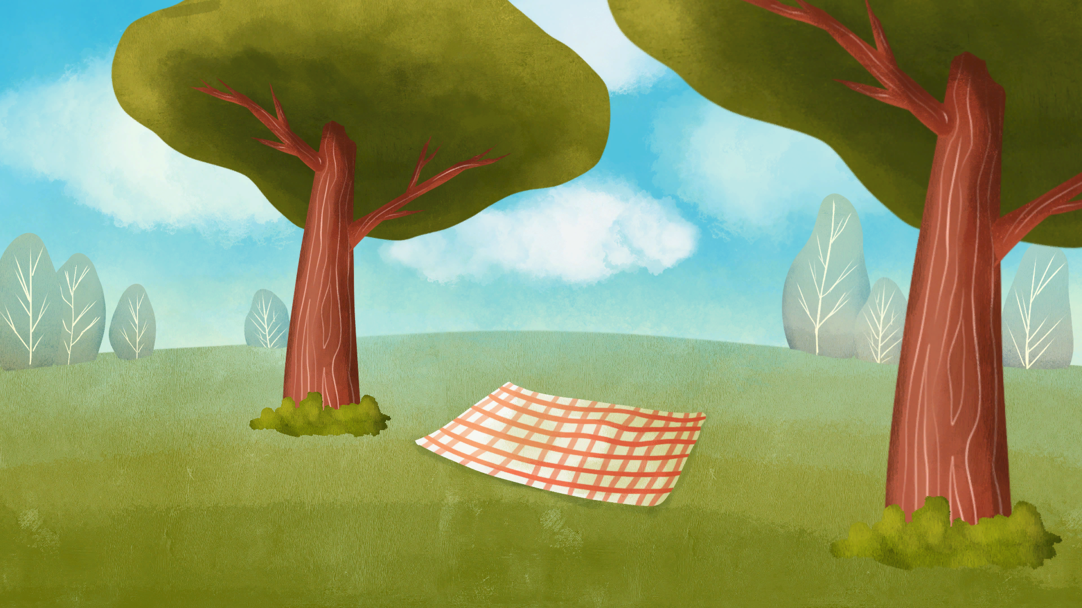
Two stories to explore
The picnic
Rabbit feels pressured to explain being late.
Fable listens to the friends and helps Bear
understand their feelings. Rabbit can choose
quiet company or more time.
Bear and the bees
Bear took honey without asking. Fable helps
both sides talk. Bear apologizes and asks
permission. The bees decide what to share.
Listening, personal space and consent
become part of the story.
Fabletail / 3
Notes:
Project: Docs/PicnicPrototype.md, Docs/PicnicRevisionPlan.md, Docs/HideAndSeekPrototype.md, Docs/ArtIntegrationReview.md, Docs/OpenForestRevision.md, Docs/FinalJamAdditions.md. Documentation reviewed 20 October 2026. Player name Fable and game name Fabletail supplied by the team. Images are existing project art/captures and may predate the final UI. Picnic image is the artist-authored environment, not a final gameplay capture. Stories offer opportunities for practice; no learning outcomes have been measured.

Slide 4
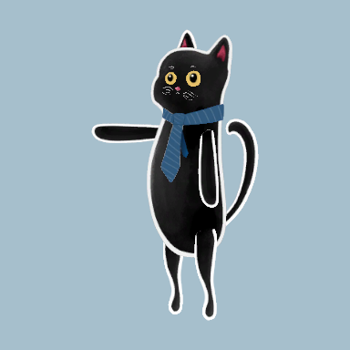
Help stays the child’s choice
The child leads
Mouse and keyboard control Fable. The child
uses the in-game phone to invite a parent
or caretaker, and can end help at any time.
An optional companion
The adult joins locally with a controller.
Every story can be completed alone,
and leaving help preserves story progress.
Fabletail / 4
Notes:
Project: Docs/PicnicPrototype.md, Docs/PicnicRevisionPlan.md, Docs/HideAndSeekPrototype.md, Docs/ArtIntegrationReview.md, Docs/OpenForestRevision.md, Docs/FinalJamAdditions.md. Documentation reviewed 20 October 2026. Player name Fable and game name Fabletail supplied by the team. Images are existing project art/captures and may predate the final UI. Companion controls: left stick moves, A interacts/confirms, D-pad or stick selects, B backs out. Child invitation is required. The child owns key story resolutions. Synthetic Editor tests cover permission/disconnection; physical controller testing and family usability review remain outstanding.

Slide 5
The prototype and what comes next
The jam prototype
Two connected story chapters, animated animal characters,
branching dialogue and optional local parent support.
No countdown or loss of story progress for mistakes.
Next steps
Playtest with autistic children and caregivers, alongside
clinical advisors. Refine reading demands, pacing and sensory
options around their feedback before adding more stories.
Game jam prototype. Educational and clinical benefits have not been evaluated.
Fabletail / 5
Notes:
Project: Docs/PicnicPrototype.md, Docs/PicnicRevisionPlan.md, Docs/HideAndSeekPrototype.md, Docs/ArtIntegrationReview.md, Docs/OpenForestRevision.md, Docs/FinalJamAdditions.md. Documentation reviewed 20 October 2026. Player name Fable and game name Fabletail supplied by the team. Images are existing project art/captures and may predate the final UI. Unity 6000.3.15f1 with Adventure Creator 1.86.7. Existing Editor tests are documented, but latest taxi/UI changes were compilation-checked only. This presentation does not verify the submitted executable. Do not claim clinical validation or demonstrated transfer to everyday life.

