Slide 1

PILL HEROES
Play. Progress. Remember.
A casual Match-3 experience designed around medication routines, positive reinforcement, and meaningful rewards.
GAME CONCEPT / SCREEN WALKTHROUGH

Slide 2
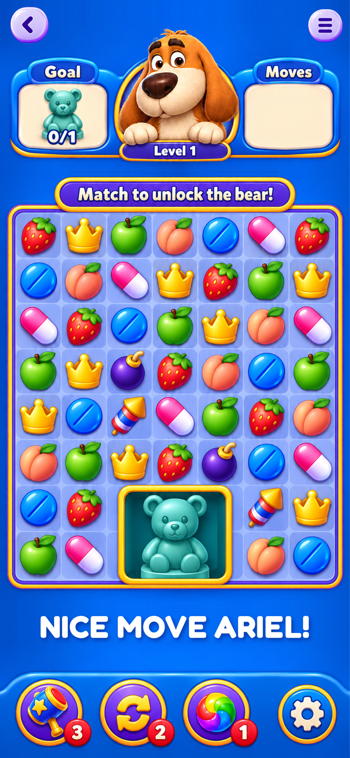
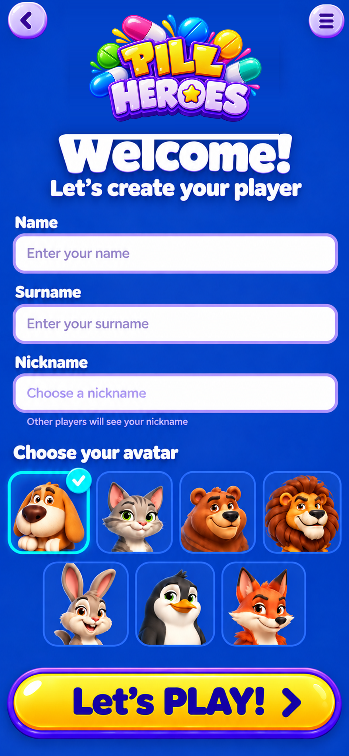
01 / THE CONCEPT
A game with a purpose
Casual Match-3 gameplay
A familiar, accessible puzzle experience.
Medication routine integration
Pill plans and reminders appear within the game journey.
Motivation through rewards
Progress, daily bonuses, and personalized prizes.
02

Slide 3
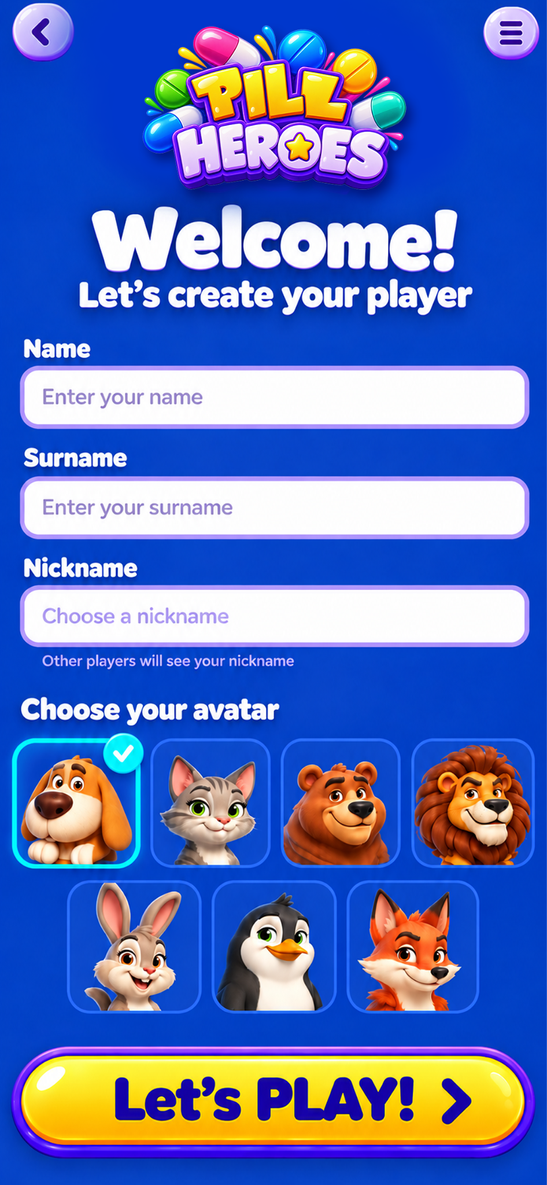
02 / INTRODUCTION
A friendly first impression
Personal player profile
Name, surname, and visible nickname.
Choose an avatar
Friendly animal characters encourage ownership.
Clear entry point
A bold “Let’s PLAY!” call to action.
03

Slide 4
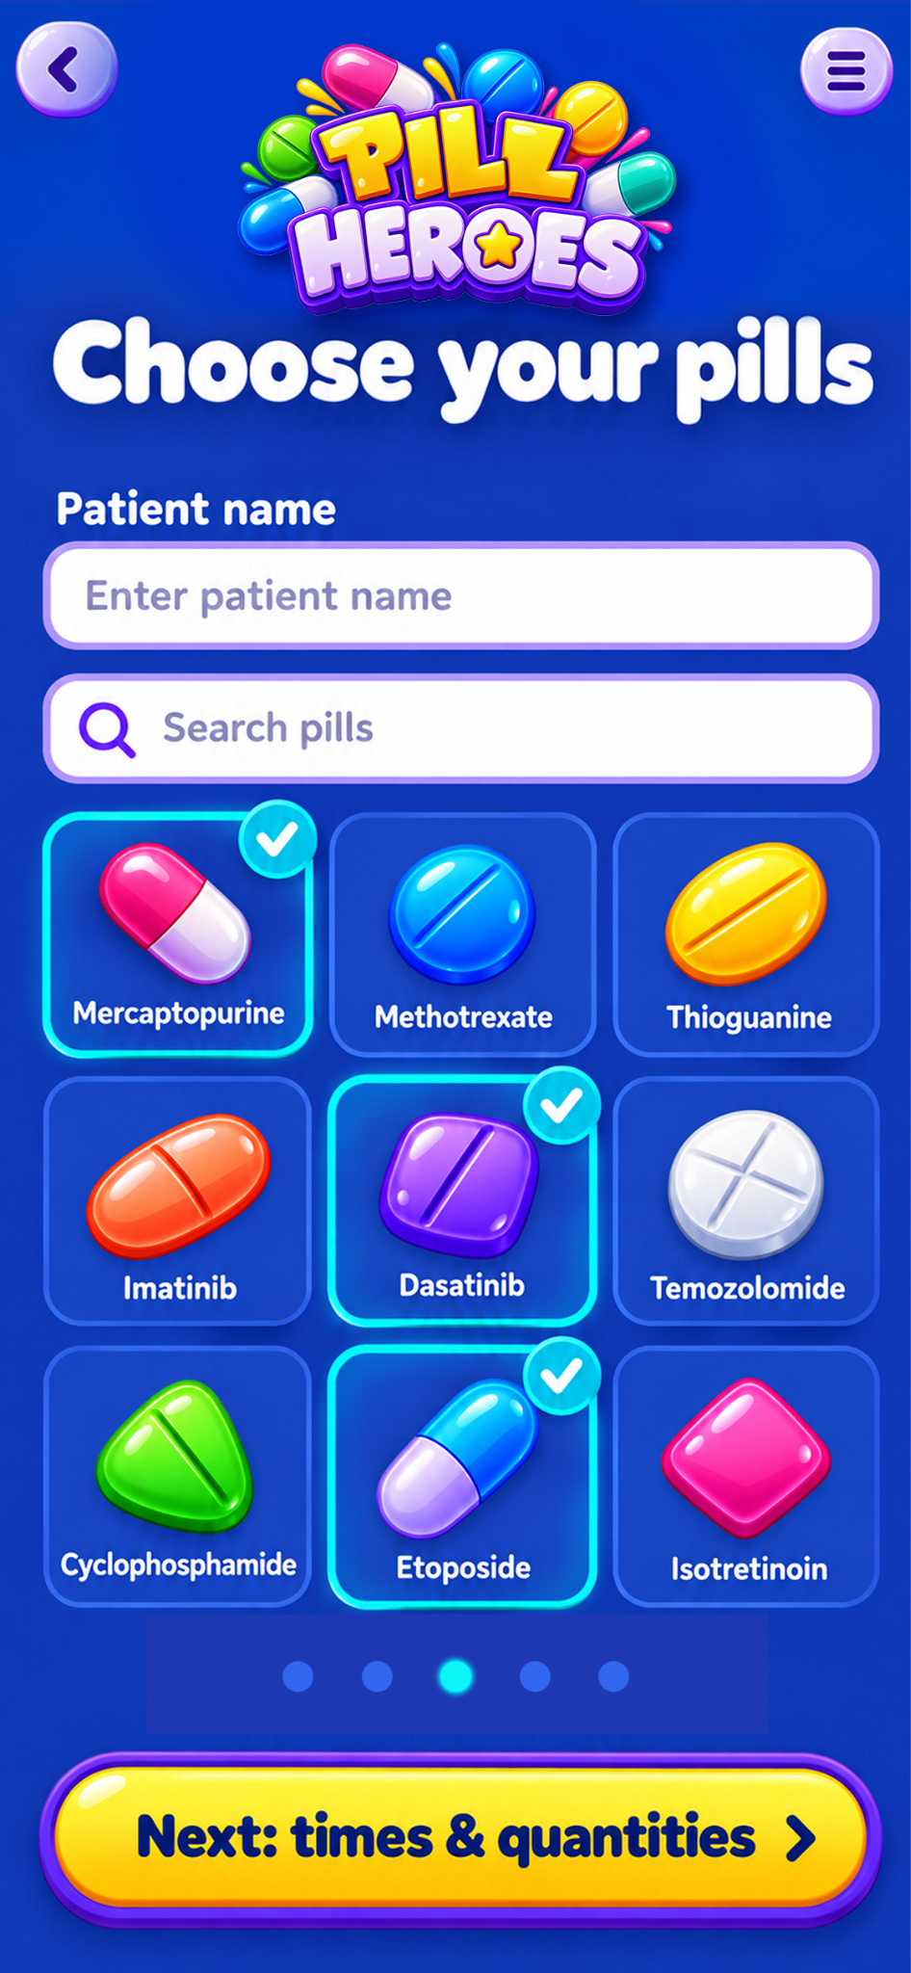
03 / MEDICATION SETUP
Build a personalized pill plan
Choose medications
Browse or search a visual pill library.
Simple selection
Selected medications receive clear checkmarks.
Staff-supported setup
The screen presents a patient setup workflow.
04

Slide 5
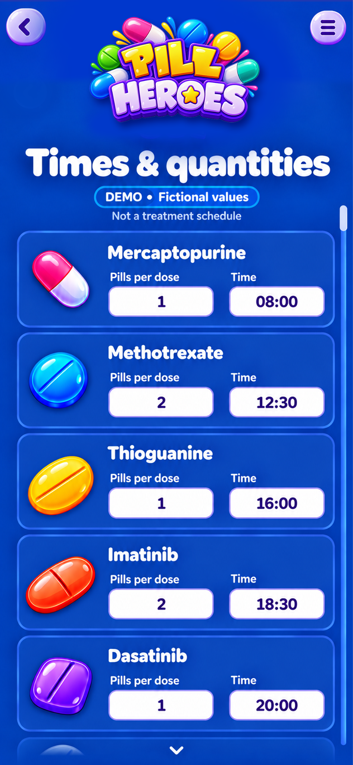
04 / SCHEDULING
Set times and quantities
Dose configuration
Specify quantity per dose for each medication.
Time-based schedule
Assign a time to each selected medication.
Review before play
A dedicated review step completes the plan.
05

Slide 6
05 / CORE GAMEPLAY
Match, collect, unlock
Match-3 puzzle board
Colorful tiles, power-ups, and simple objectives.
Level progression
Complete goals to unlock collectible characters.
Instant feedback
Friendly mascot and celebratory messaging.
06

Slide 7
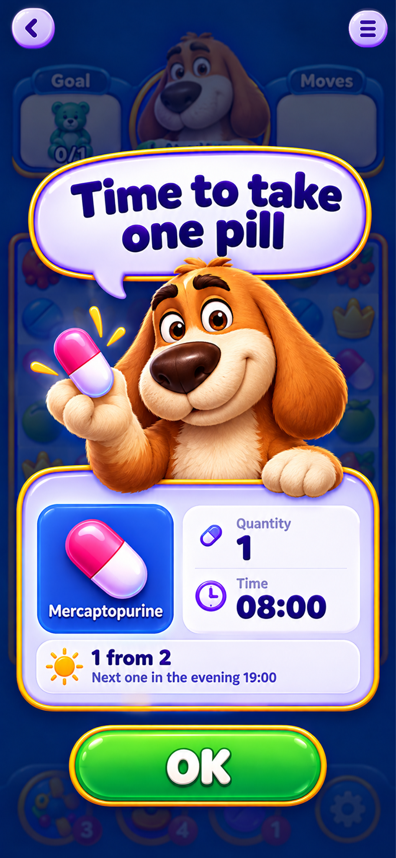
06 / PILL REMINDER
A reminder inside the game
Pause at the right moment
Gameplay is interrupted by a prominent reminder.
Make the dose clear
Medication name, quantity, and scheduled time.
Show what comes next
Dose progress and next reminder time.
07

Slide 8
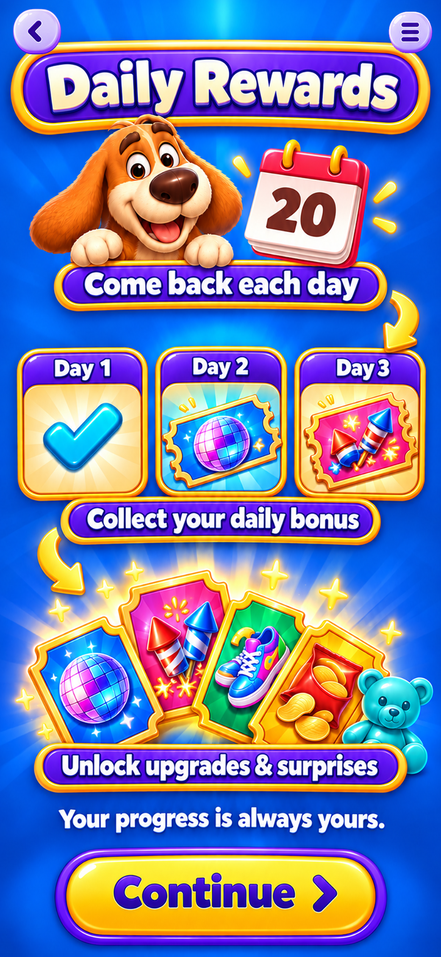
07 / DAILY ENGAGEMENT
Make every return rewarding
Daily reward progression
A sequence of bonuses across multiple days.
Surprise and anticipation
Coupons, collectible items, and special gifts.
Positive reinforcement
Rewards encourage return visits and engagement.
08

Slide 9
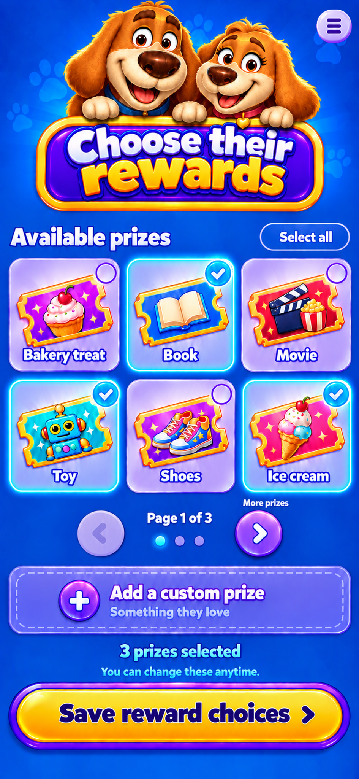
08 / PARENT & STAFF TOOLS
Reward choice and control
Personalize the incentives
Choose prizes that matter to the player.
Flexible reward catalog
Select from multiple categories or add a custom prize.
Supportive involvement
Adults can help tailor the motivation system.
09

Slide 10
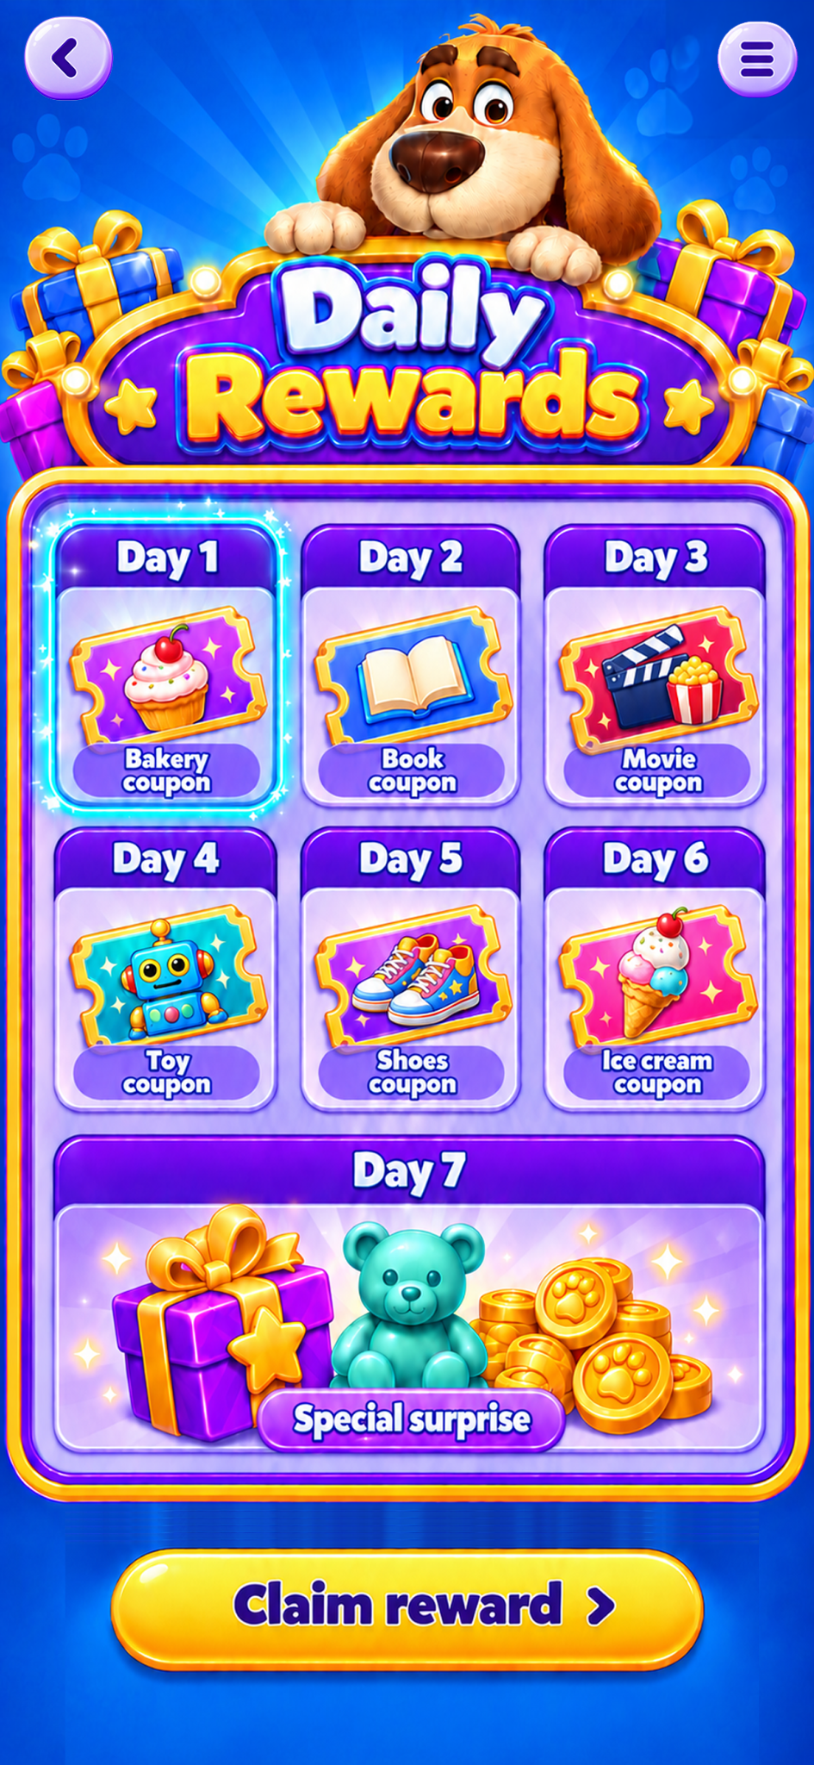
09 / REWARD SYSTEM
More ways to stay engaged
Game upgrades
Disco-ball and firework-style rewards.
Daily milestones
A simple day-by-day bonus sequence.
Longer-term progression
A mix of virtual upgrades and surprises.
10

Slide 11
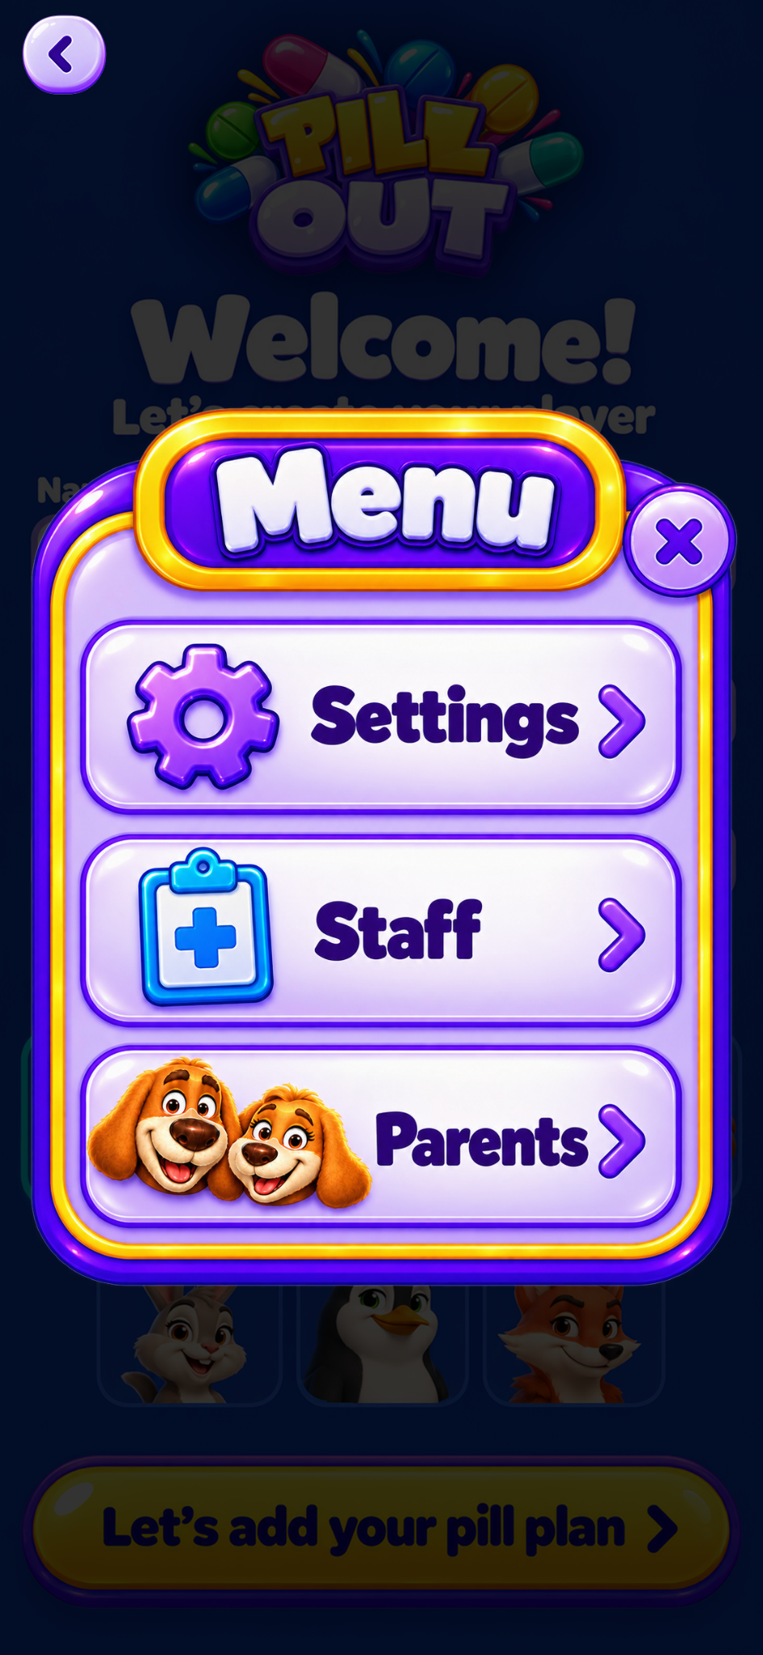
10 / NAVIGATION
Support beyond the game
Settings
Access to game preferences.
Staff area
A visible entry for staff-oriented features.
Parents area
A dedicated pathway for parent involvement.
11

Slide 12
11 / SUMMARY
A playful routine, built around progress
PLAY
REMEMBER
REWARD
Match-3 challenges and collectible goals
Clear pill reminders integrated into play
Daily incentives and personalized prizes
Pill Heroes brings game engagement and routine support into one colorful, approachable experience.
Concept visuals and medication schedules are illustrative only; not medical guidance.
12

