Slide 1




CONCH
Where Imagination Plays
The Adventure Streaming Platform
+
Subscription audio streaming
in-platform creator tools,
community economy
Mood video
Website
Tutorials
in [contact omitted]

Slide 2

Why is Conch Here? FEATURED
Imagination is crucial for humanity.
It drives empathy and powers creative problem-solving. These are the skills that define our species.
Screen entertainment doesn't exercise it. It replaces it.
Conch is bringing imagination back, playfully

Slide 3


What is Conch?
The adventure streaming creator platform
Play
Create
Subscribe
Speak your actions. Hear the world respond.
Build communities and monetize adventures on our platform.
One monthly fee, unlimited adventures.
“You enter the room and see a dragon sleeping in the far corner”
“I’ll try to walk quietly past him.”
“I want to create a murder mystery”
“Great, does it start in the crime scene?”

Slide 4
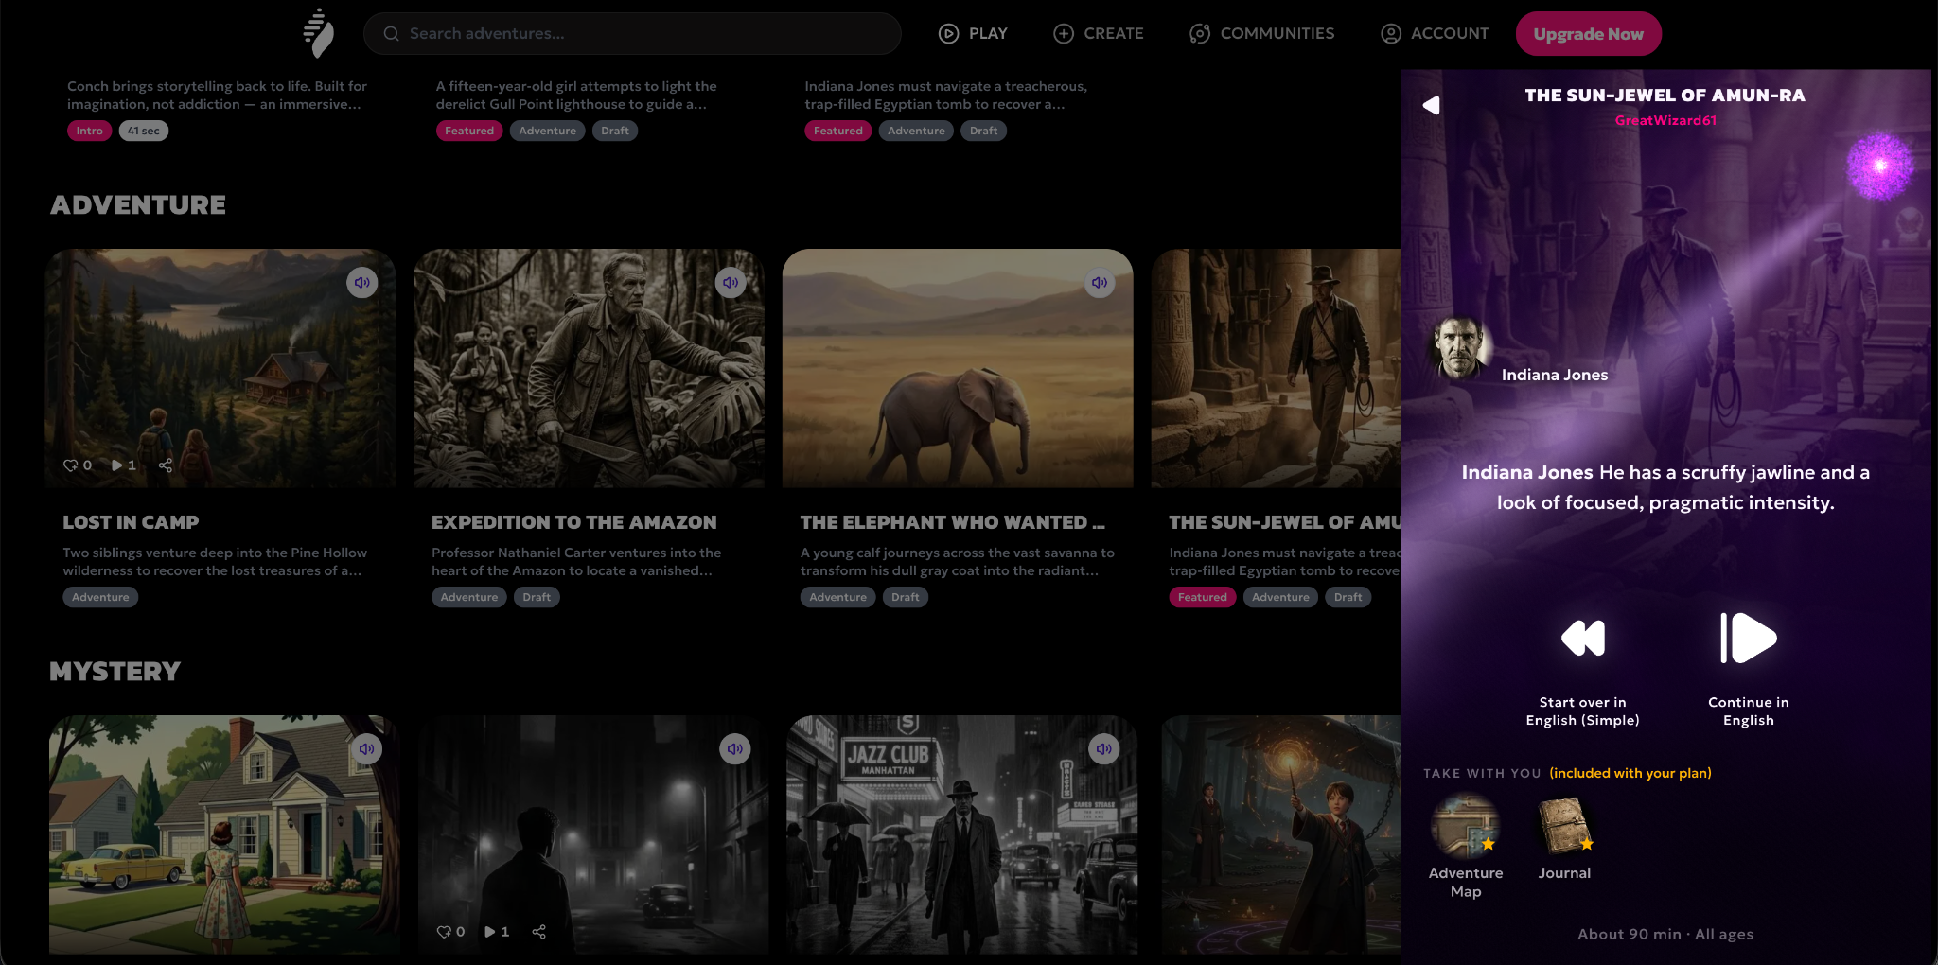

What an Adventure looks like?

Slide 5
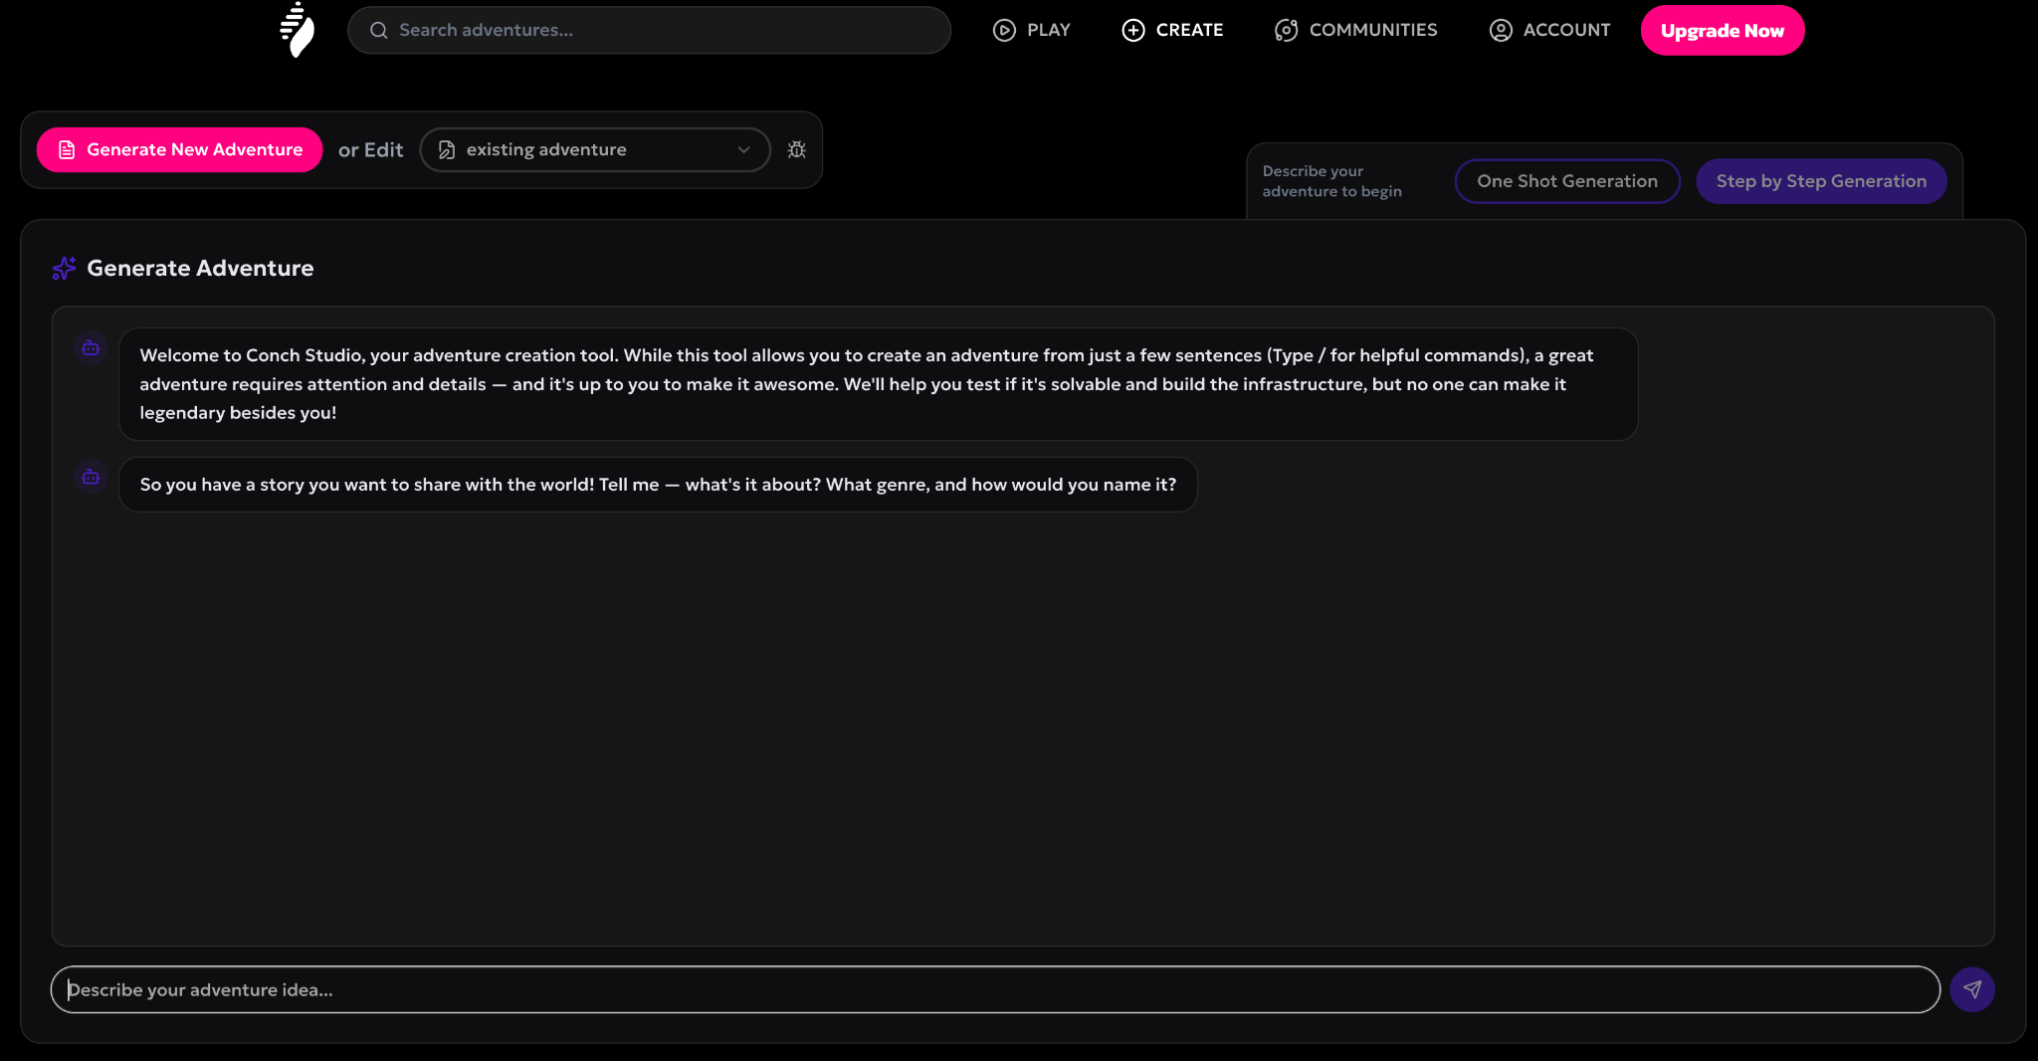
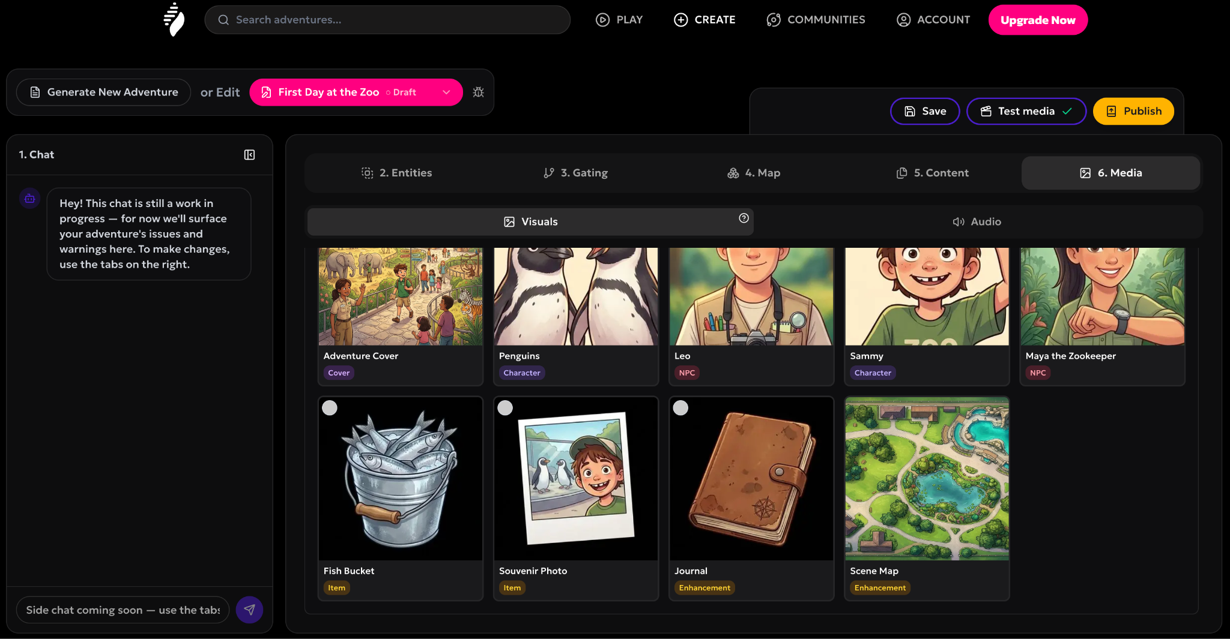
What The Studio looks like?

Slide 6




New Entertainment Category
Adventure Streaming — More engaging than books, Much healthier than screens. Eliminating the Dopamine Crash.
Catalog Streaming
Engaging/Immersive
Video games
Nex
CONCH
Music
Movies
Books
Dopamine parachute
Short videos
TV
The dopamine crash
Videos
Gaming
Adventures
Healthy/Imaginative
Podcasts
Books

Slide 7




Why Now?
AI Breakthroughs
Audio Renaissance
LLMs and voice AI have reached the quality & price threshold for compelling interactive narratives.
Podcasts have normalized audio-first entertainment. Next evolution is interactive audio (PA).
Screen Time Crisis
Creator Economy Matured
Parents are seeking healthy alternatives. Regulators are limiting children's digital content.
Patreon proved creators can monetize communities. Infra for creator-led platforms is mature

Slide 8
Who is Conch For?
Players - Families with children 7-14
Creators & Educators
The underserved
An immersive audio experience, playable by voice alone. Blind and visually impaired players can enjoy full adventures without a screen, children with ADHD can practice daily routines, and autistic children can practice social interaction at their own pace.
Our beachhead. Tweens who love stories, games and prefer something engaging in their downtime. Parents seeking quality alternatives to screen time, something they can always say yes to. Unlimited (Safe, No Screen Fatigue, COPPA-compliant)
A new medium to easily build, share, and monetize interactive audio adventures. No coding required. Creators can build communities. Educators can use adventures to teach topics & spoken languages through game play.
Starting with families. Building for all ages.

Slide 9
How Conch Grows Now?
Creator Led Growth
Early access beta - building with our first users, not just for them.
Direct creator recruitment - audio storytellers, narrative podcasters and educators with existing Patreon audiences.
Community seeding in parenting and interactive fiction communities.
Press outreach - the dopamine parachute is a story parents and media both want to tell.
We don't need to invent the market.
We need to reach the parents already looking for this.

Slide 10
How Conch Grows After Seed?
Partnership Led Scale
Creator flywheel - creators bring communities, communities attract creators, platform grows without linear CAC.
Brand & IP partnerships - family IP holders seeking healthy, imaginative contexts for their audiences.
Platform partnerships (Nex) - family subscription services sharing our values, Conch as the imaginative downtime companion to active play.

Slide 11
Who does Conch compete with?
Our real competition is passive entertainment - Podcasts and (audio)books own the same needs. Unlike both, Conch is interactive.
Audio adventure apps* validate our category, But none of them are built for us to compete with:
 | CONCH | Adventure Apps | Vibe Coding Gaming
Audience | Families, 7-14 | Adults / RPG enthusiasts | All ages
Experience | Audio, imagination-first | Screen-dependent | Screen-first
Creator monetization | Patreon integration | None | Varies
Game engine | Narrative Engine | Narrative Engine | Physical engine
Family-safe / COPPA | ✓ | ✗ | ✗
*Category validators: Voyage (Latitude) · Giant · Hidden Door · FableAI · Vobble

Slide 12
Business Model
Subscription model - like Spotify and Nex* - One monthly fee. Unlimited adventures. No ads, no microtransactions.
.
Full Library Access
Constant New Content
No Ads or Microtransactions
Unlimited adventures for one predictable price
Fresh adventures added regularly keep engagement high. Creators create monetizable communities
Clean, family-friendly experience parents trust
Better Value
Easier for Parents
Production costs under $1
Comparable to one video game but unlocks an entire platform
One decision, no ongoing purchase requests from kids
Generated content — no production treadmill, no green-light bets.
*Nex validated family subscription entertainment — #3 best-selling gaming device on Black Friday '25, outselling Xbox

Slide 13
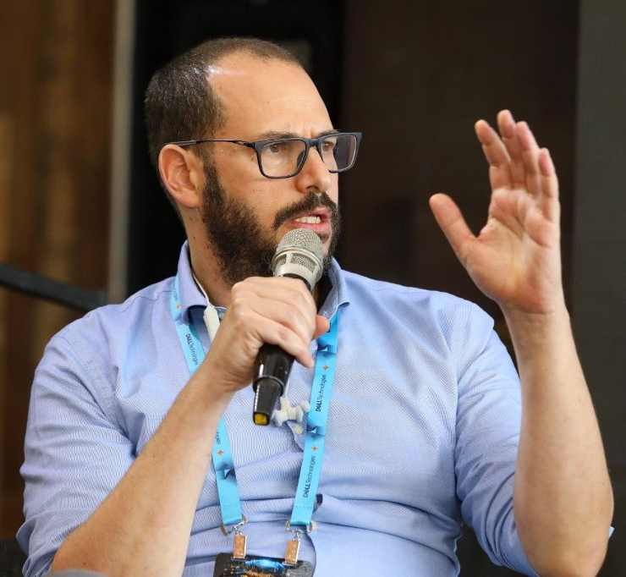
Gadi Zimerman
Founder and CEO
Seasoned VP of engineering and product with a proven track record of launching successful AI products
Deep technical and product expertise - builds and ships end-to-end
Amateur game designer
MSc. in Machine learning and MBA - uniquely positioned at the intersection of AI technology and business
CONCH
Join the Adventure -
S T U D I O
in gadi@conch.ing +972548051010

