Slide 1
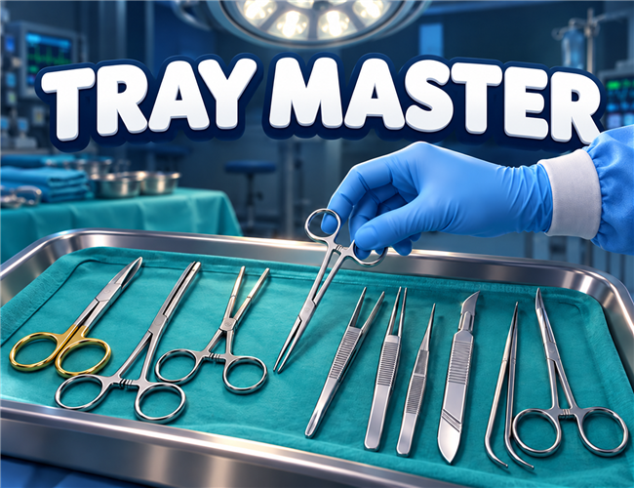
TRAY MASTER
Learn surgical instruments
through play
Instrument and tray recognition
for new operating room staff
01
Notes:
Sources: Surgical_Tool_Recognition_GDD.md; game/README.md; game/js/content.js; game/js/progress.js. Original gameplay images: videos/TrayMasterGame-final.mp4. Branding and play link: videos/build.js. Screenshots retain the recorded Hebrew game interface.

Slide 2
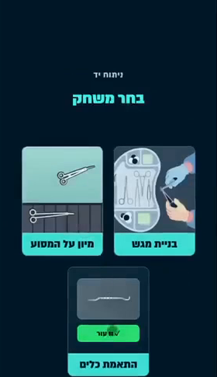
Getting to know surgical instruments
Similar names. Similar tools.
New staff need to learn instrument names,
notice small differences and know which
tools belong on each procedure tray.
The game offers repeated practice
with feedback on each choice.
02
Notes:
Sources: Surgical_Tool_Recognition_GDD.md; game/README.md; game/js/content.js; game/js/progress.js. Original gameplay images: videos/TrayMasterGame-final.mp4. Branding and play link: videos/build.js. Screenshots retain the recorded Hebrew game interface. The game supports practice for new staff. No measured clinical or educational effectiveness is claimed.

Slide 3
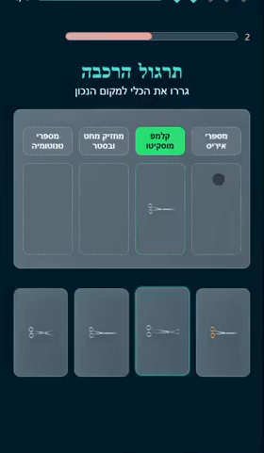
Matching names to instruments
A name becomes a recognisable tool
Match each instrument to its label.
The exercise connects the professional
term with the shape on screen.
Choose a procedure and practise
with the instruments on its tray.
03
Notes:
Sources: Surgical_Tool_Recognition_GDD.md; game/README.md; game/js/content.js; game/js/progress.js. Original gameplay images: videos/TrayMasterGame-final.mp4. Branding and play link: videos/build.js. Screenshots retain the recorded Hebrew game interface. Players can drag a name to its illustration or tap the name and then the tool. The screenshot captures the matching exercise.

Slide 4
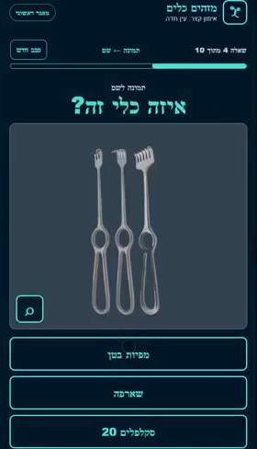
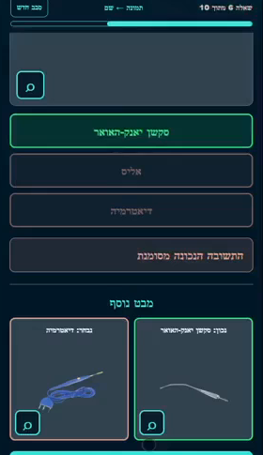
Recognition with immediate feedback
Each choice is a chance
to learn
Choose the instrument’s name
from several options.
Feedback shows the answer
and lets players compare
easily confused instruments.
04
Notes:
Sources: Surgical_Tool_Recognition_GDD.md; game/README.md; game/js/content.js; game/js/progress.js. Original gameplay images: videos/TrayMasterGame-final.mp4. Branding and play link: videos/build.js. Screenshots retain the recorded Hebrew game interface. The two screenshots show separate examples: an identification question and feedback from a different choice. They are not a single question-and-answer sequence.

Slide 5
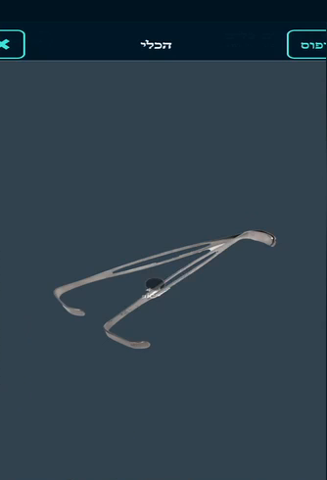
A closer look in 3D
Rotate, zoom and inspect the details
Examine a tool from different angles
to learn its shape and the details that
distinguish it from similar instruments.
The instrument library is available
for independent study and during practice.
05
Notes:
Sources: Surgical_Tool_Recognition_GDD.md; game/README.md; game/js/content.js; game/js/progress.js. Original gameplay images: videos/TrayMasterGame-final.mp4. Branding and play link: videos/build.js. Screenshots retain the recorded Hebrew game interface. The instrument viewer supports rotation and zoom. The screenshot is an actual instrument-library view from the recording.

Slide 6
Already playable: naming to tray building
1. Naming game
2. Tray Builder
Learn the names and recognise
individual instruments.
Then find the called instruments
and complete a tray in the 3D game.
Same procedure
Available now
Choose a procedure and practise
with its instrument set in both games.
Both games are already implemented.
Switch between them in the game menu.
06
Notes:
Implemented learning progression, not a future feature: naming/matching first, then Tray Builder for the same procedure. Sources: game/README.md (What is in it, Phones first) and game/js/game.js (startMatching, renderGames, startTray). Both games are available in the game picker. This is a recommended learning sequence, not an automatic unlock or automatic transition. Other implemented modes and progress tracking remain available.

Slide 7
Phone, tablet and computer
Phone
Tablet
Computer
Play directly in the browser
Open the link or scan the QR code.
No installation required.
A responsive interface
The layout adapts to the screen size,
so players can practise wherever
and whenever it suits them.
07
Notes:
Source: game/README.md, sections Run it, Phones first and Controls; game/css/style.css. The browser build supports phones, tablets and desktop computers with responsive layouts and touch or mouse controls. Online browser access is required. Progress is stored locally in the browser, not synchronised across devices. Different devices show different menus and modes.

Slide 8
Business potential for clinical teams
Potential benefits to validate in a clinical pilot
Time saved
Less time looking up instruments or repeating
basic explanations during onboarding.
Fewer mistakes
Practise lookalike tools and tray sets to help
prevent selection and preparation mix-ups.
Training value to measure
Value measured teaching-time savings using
the hospital’s actual staff costs.
Pilot measures: recognition time, selection accuracy and trainer hours per learner.
08
Notes:
Potential business benefits remain hypotheses for TRAY MASTER. There is no validated estimate of time saved, payroll savings, prevented patient harm or adoption. Measure net teaching and learner time versus current training, including game time, then value each role using the hospital’s actual loaded hourly cost and deduct rollout, licence and content-review costs. Instrument-recognition errors in a test must not be equated with clinical incidents prevented. Implemented product context: game/README.md. Relevant external evidence is on slides 9 and 10.

Slide 9
Published evidence for instrument training
Related-product research: a randomised PeriopSim trial completed by 93 nurses
93.2% vs 80.6%
31.4 s vs 40.1 s
Correct instrument identification
Mean task completion time
Simulation before the real-instrument test
compared with testing before simulation.
A timed neurosurgical instrument task.
This is task speed, not training hours saved.
Evidence for the approach, not TRAY MASTER results. Single-centre study;
no active instructor-led comparison or demonstrated financial savings.
Clarke et al., BMJ Simul Technol Enhanc Learn (2021), 7:146–153
09
Notes:
Source: https://pubmed.ncbi.nlm.nih.gov/35518567/ Full text: https://pmc.ncbi.nlm.nih.gov/articles/PMC8936786/ DOI: 10.1136/bmjstel-2019-000576. The abstract reports 93 nurses completed the trial. Day-1 real-instrument results: 93.2% versus 80.6% accuracy, 31.4 versus 40.1 seconds. Group A used PeriopSim before testing; Group B tested before using it. This was a single-centre neurosurgical instrument study, not a TRAY MASTER trial or a comparison with conventional instructor-led training. Two coauthors disclosed advisory-board roles and stock options in the supplier. No financial savings or patient-harm reduction were demonstrated. Accessed 21 October 2026.

Slide 10
Documented training need and workforce
Published context for the opportunity. These are not predicted users or savings.
715 hours
118,400 jobs
Israeli training benchmark
U.S. surgical technologists
Hadassah’s 2024 OR nursing course
for learners without OR experience:
299 theory + 416 clinical hours.
BLS employment estimate for 2025.
A relevant workforce segment, not a
forecast of TRAY MASTER adoption.
The game addresses instrument practice within broader training.
We have not measured how much of this training it can shorten.
Hadassah: 2024 OR nursing course
U.S. Bureau of Labor Statistics: 2025 employment
10
Notes:
Training source: https://he.hadassah.org.il/nursing-school/operating-room-2024/ The 2024 course lists 299 theoretical hours and 416 clinical hours for the no-OR-experience route; 715 is their calculated sum. This is the full course, not instrument-recognition time or hours replaceable by the game. Workforce source: https://www.bls.gov/ooh/healthcare/surgical-technologists.htm BLS estimates 118,400 surgical technologist jobs in the United States in 2025. Jobs are not necessarily unique people; this is neither an Israeli workforce estimate nor an adoption forecast or a validated total addressable market. User reach must be established with clinical partners. Both accessed 21 October 2026.

Slide 11

Your next tray is waiting
TRAY MASTER
Scan the code
and start playing
spacesquidgames.itch.io/tray-master
A practice game alongside professional training
11
Notes:
Sources: Surgical_Tool_Recognition_GDD.md; game/README.md; game/js/content.js; game/js/progress.js. Original gameplay images: videos/TrayMasterGame-final.mp4. Branding and play link: videos/build.js. Screenshots retain the recorded Hebrew game interface. Play: https://spacesquidgames.itch.io/tray-master. The existing verified QR code is retained. A practice tool alongside professional training.

