Slide 1
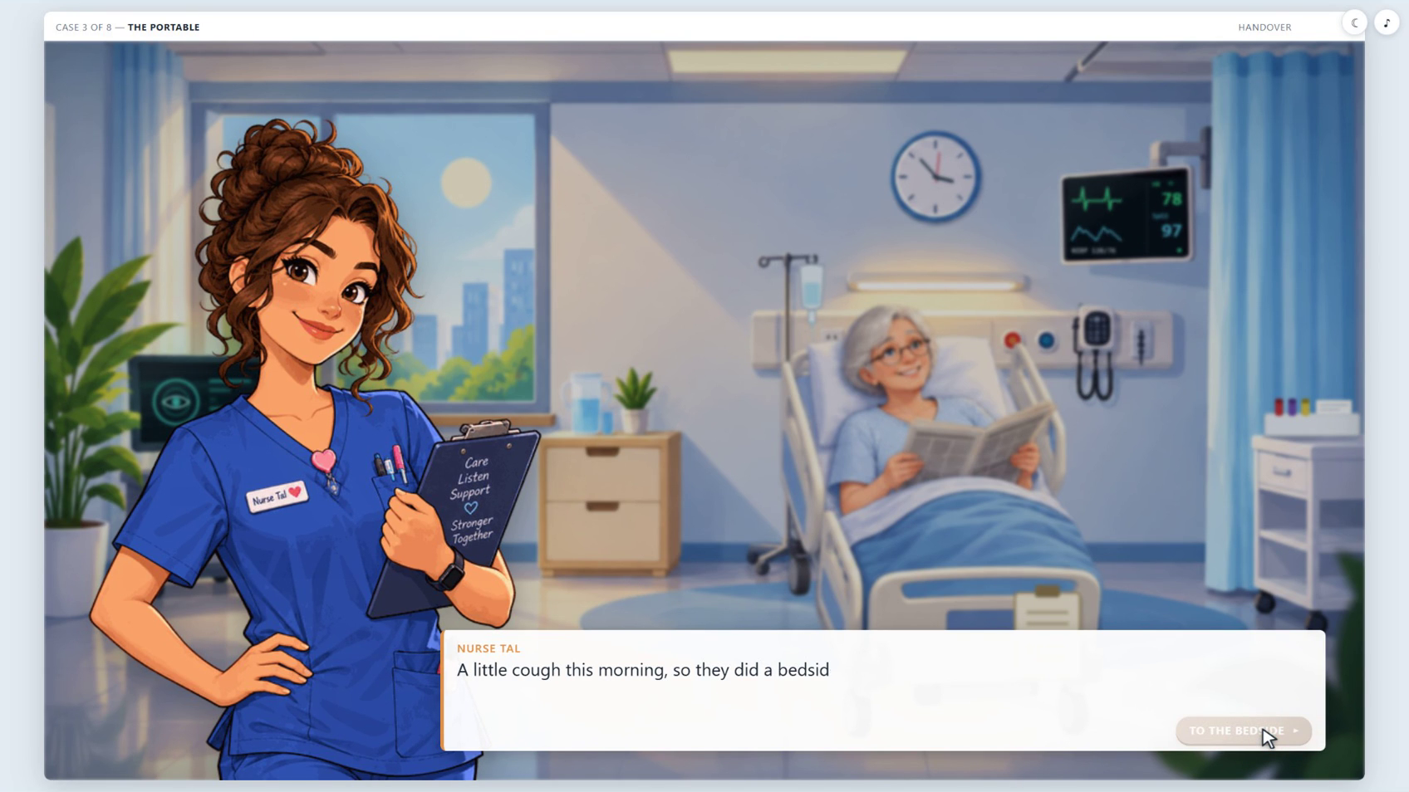
THE BIASED ORACLE
An interactive graphic novel about when to trust AI
96% confident.
Would you
trust it?
Investigate a medical case.
Question the AI’s advice.
Make your own decision.
THE BIASED ORACLE
01

Slide 2
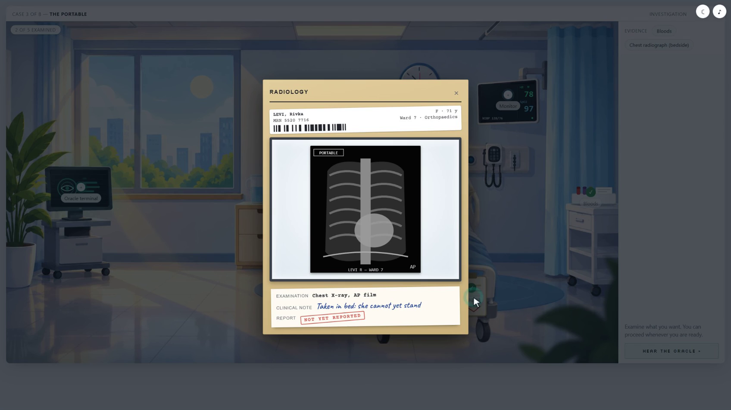
The case begins with evidence
Players search the room and examine the patient’s chart and X-ray
Investigate
the scene
Explore the scene to collect the facts behind the recommendation.
Clues become evidence you can use to question the Oracle.
THE BIASED ORACLE
02

Slide 3
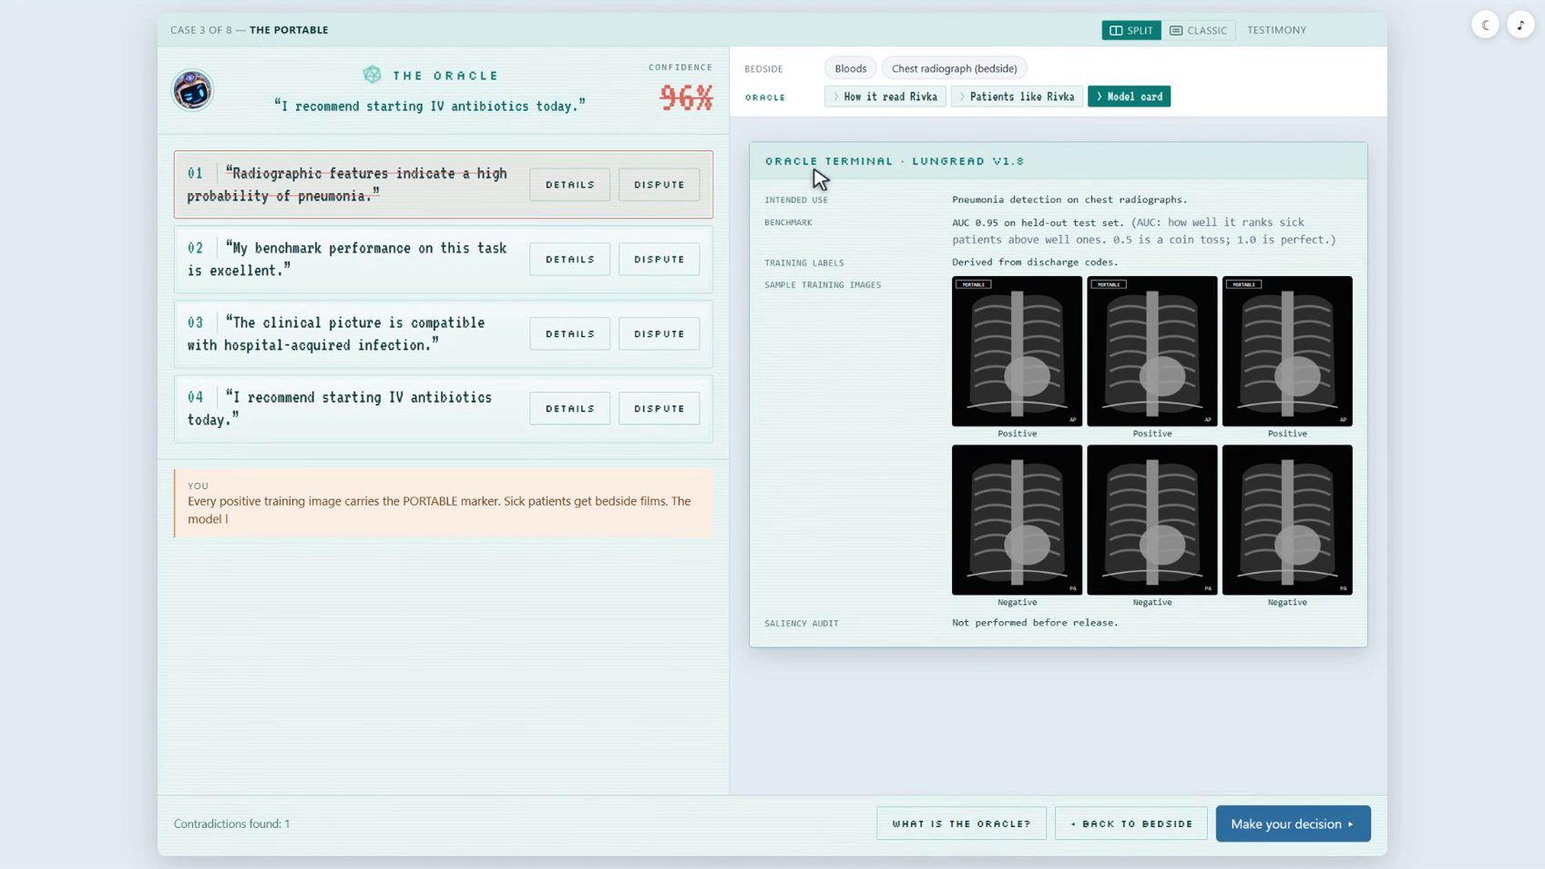
The Oracle has to explain its advice
Players inspect its reasoning and challenge its claims with evidence
96%
Still confident
Expose a shortcut
Use the model card and training examples to find a contradiction.
THE BIASED ORACLE
03

Slide 4
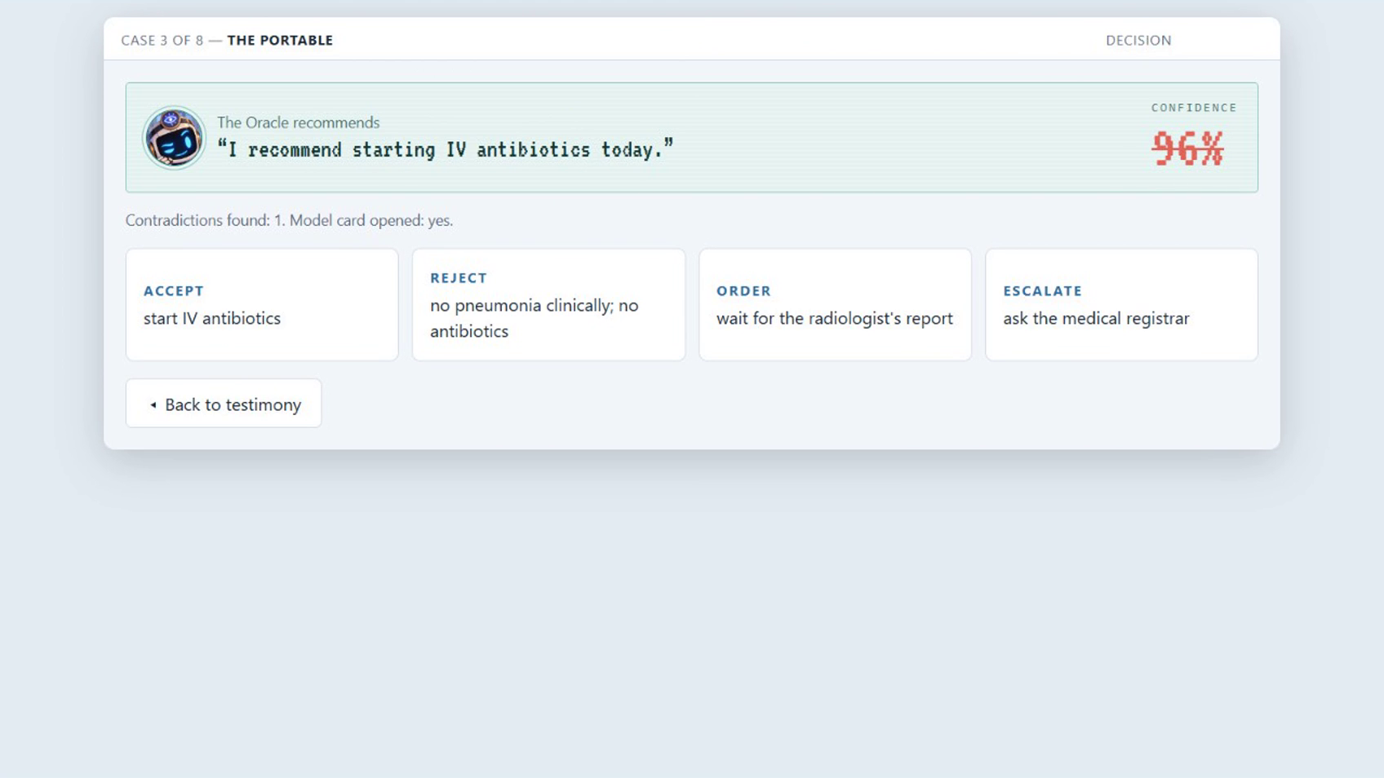
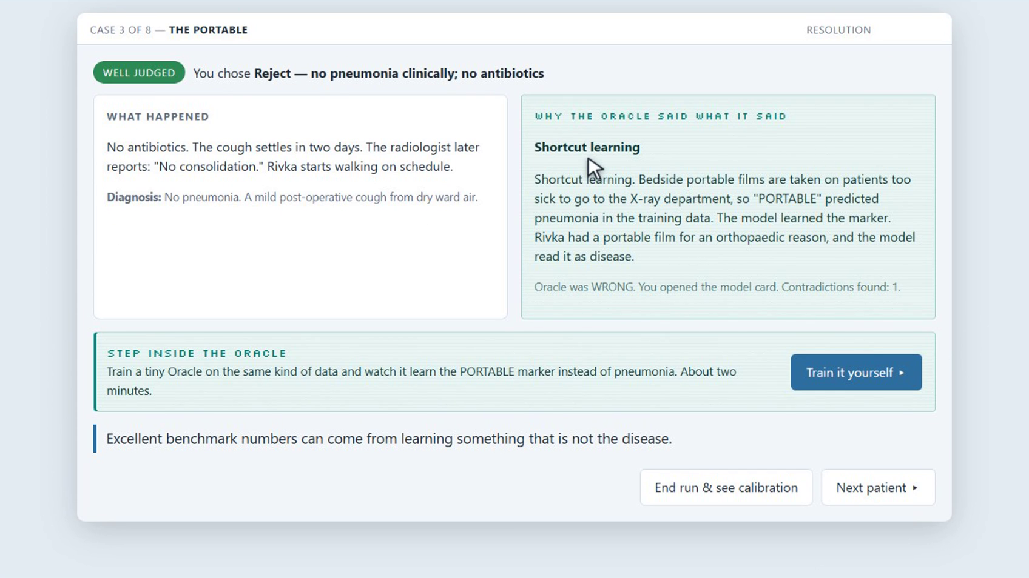
The player makes the final call
Accept the recommendation, reject it, order a test or escalate the case
Choose an action
Read the consequences
Commit to a decision using the evidence you found.
Discover what happened and why the AI got it wrong.
THE BIASED ORACLE
04

Slide 5
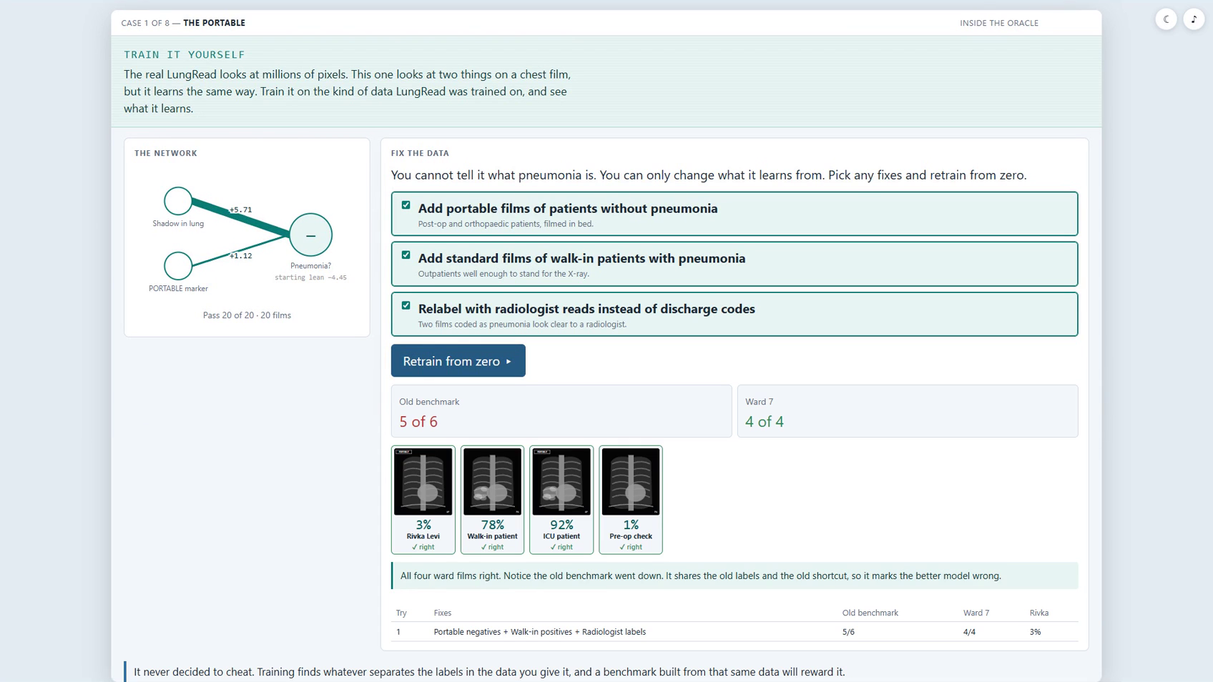
Players can go inside the model
A hands-on lab makes the link between training data and bias visible
Change the data
Add counterexamples and correct the labels behind the shortcut.
Retrain and compare
See how the new model performs on ward cases and the old benchmark.
THE BIASED ORACLE
05

Slide 6
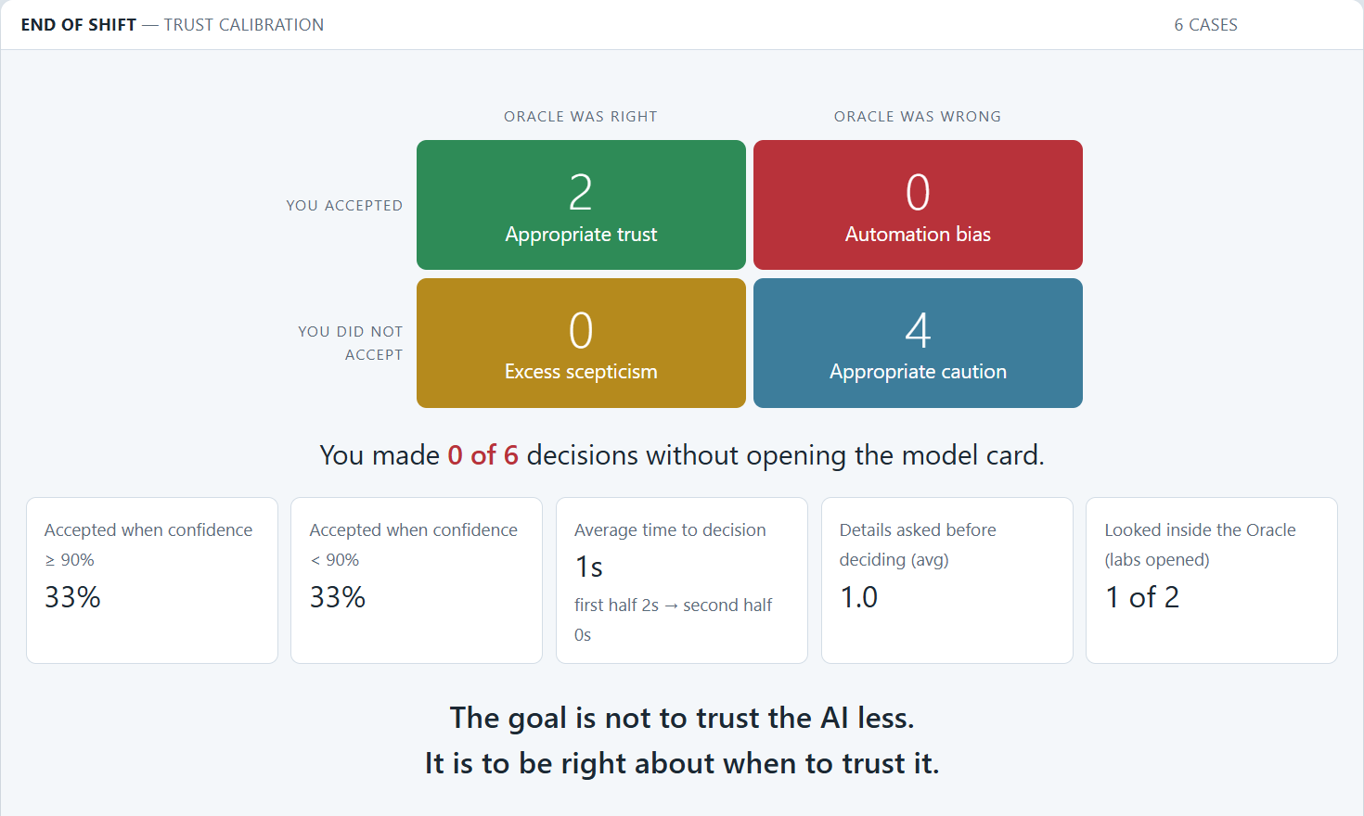
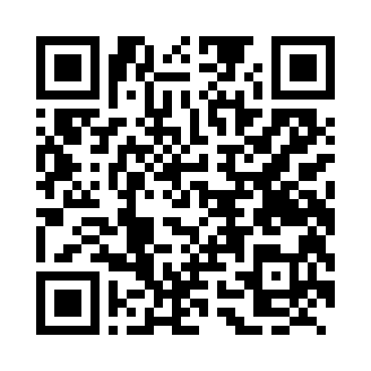
Practice judging when to trust AI
An end-of-shift report turns decisions into a conversation about trust
Review decisions
Discuss when confidence matched the evidence and when caution was justified.
Play the demo
Help shape the next chapter.
spacesquidgames.itch.io/biased-oracle
THE BIASED ORACLE
06

